Slide 1
Joe Serna, Jr. Farmworker Housing Grant Program Overview
California Department of Housing and Community Development

Slide 2
AGENDA
Introductions
Getting Started
Applicant Eligibility and Experience
Eligible Activities
Grant Amounts and Requirements
Loan Amounts and Requirements
Minimum Number of Assisted Units and Affordability
Site Control
Threshold
Feasibility
Evaluation Criteria

Slide 3
HCD Staff (1 of 2)
Craig Morrow, Branch Chief, Access to Opportunity
Deb Lindfeldt, Section Chief, Access to Opportunity
Mauro Lara, Manager, Program, Design & Implementation
Doug Truong, Manager, Program, Design & Implementation
Gabriella Navarro, Specialist I, Program, Design & Implementation

Slide 4
HCD Staff (2 of 2)
Amy Lopez, Housing Representative II, Program, Design & Implementation
Tawny Macedo, Senior Policy Specialist, Fair Housing
Joshua Standing Horse, Senior Policy Specialist, Tribal Affairs
Spring Packard, Housing Representative II, Housing Policy Division

Slide 5
Introductions
Tribal Members and Partners
Name
Role
Organization
Is your tribe federally recognized?

Slide 6
Welcome
Welcome from Branch Chief, Craig Morrow

Slide 7
Getting Started

Slide 8
Purpose
Joe Serna, Jr. Farmworker Housing Grant (FHWG) Program funds will be used to provide deferred-payment loans for new construction or rehabilitation of multifamily housing and grants for single-family new construction or owner-occupied rehabilitation programs, to address the housing needs of agricultural workers.

Slide 9
Authorities
Governed by:
2017 Uniform Multifamily Regulations (commonly referred to as UMR’s)
State Program Regulations: Title 25 California Code of Regulations (CCR) Section 7200
Notice of Funding Availability (NOFA) and Notice of Guidelines Memorandum

Slide 10
Important Dates
Notice of Funding Availability (NOFA) Posted:
February 26, 2021
Formal Webinar:
March 18, 2021
Application Portal Open:
April 5, 2021 through July 6, 2021

Slide 11
Key Definitions (1 of 6)
"Agricultural household" means an agricultural worker or workers and other persons who reside or will reside with an agricultural worker in an assisted unit.
"Agricultural worker" means an individual who derives or prior to retirement or disability derived a substantial portion of his/her income from agricultural employment.

Slide 12
Key Definitions (2 of 6)
"Agricultural employment" means employed in the cultivation and tillage of the soil; the production, cultivation, growing and harvesting of any agricultural or horticultural commodities; the raising of livestock, bees, furbearing animals, or poultry; dairying, forestry, and lumbering operations; and any work on a farm as incident to or in conjunction with such farming operations, including the delivery and preparation of commodities for market or storage.

Slide 13
Key Definitions (3 of 6)
"Assistance" means a loan and/or grant provided from the Fund to an applicant, or a grant made directly to an agricultural worker.
"Award" means a commitment of money from the Fund in the form of a grant or a loan that is made to a recipient by the Department.

Slide 14
Key Definitions (4 of 6)
"Lower income households" means persons and families whose gross incomes do not exceed the qualifying limits for lower income families These limits are equivalent to 80 percent of the area median income, adjusted for family size and other adjustment factors by the United States Department of Housing and Urban Development.
“OTC” stands for Over the Counter, applications can be submitted during a designated time period. Applications are reviewed in order they are received. Complete applications will receive funding until the application window is closed or funds are exhausted.

Slide 15
Key Definitions (5 of 6)
“Native American Lands” means real property located within the geographic boundary of the State of California that meets both the following criteria: it is trust land for which the United States holds title to the tract or interest in trust for the benefit of one or more Indian tribes or individual Indians, or is restricted Indian land for which one or more tribes or individual Indians holds fee title to the tract or interest but can alienate or encumber it only with the approval of the United States; and the land may be leased for housing development and residential purposes under federal law.
Source: 2017 Uniform Multifamily Regulations (page 4)

Slide 16
Key Definitions (6 of 6)
“Rental Housing Development” a structure or set of structures which collectively contains 5 or more units. This does not include any “health facility” as defined by Section 1250 of the Health and Safety Code. Source: 2017 Uniform Multifamily Regulations, 8301(p)

Slide 17
APPLICANT ELIGIBILITY AND EXPERIENCE

Slide 18
Applicant Eligibility
Duly constituted governing body of an Indian reservation or rancheria or a tribally designated housing entity.
Local government agencies
Nonprofit Corporations
Limited Partnerships
Limited Liability Company
Note: For-profit entities are not eligible Applicants

Slide 19
Applicant Experience Rental Housing
Rental housing developments
Developed and owned at least one similar type and size project within the last five years; and
Have staff with demonstrated experience managing at least one project occupied primarily by Agricultural households.

Slide 20
Applicant Experience Single-Family
Single-family new construction or owner-occupied rehabilitation projects
Successfully sponsored or supervised a similar program for at least two years within the last 10 years.

Slide 21
Applicant Experience Manufactured Homes
Manufactured homes
Must be operating or will operate a program to address and remedy the impacts of displacement of Agricultural Households from existing labor camps, mobilehome parks, or other housing due to government action to enforce health and safety laws.

Slide 22
Eligible Activities

Slide 23
Eligible Activities
New construction or rehabilitation, with or without acquisition, of a Rental Housing Development
Single-family new construction (a newly built home) in which the ultimate grantees are participants
Owner-occupied rehabilitation
Repairs necessary to protect the health, safety, or welfare of occupants of the housing

Slide 24
Eligible Activities (continued)
Acquisition of Manufactured Housing
not installed on permanent foundation as part of a program to address and remedy the impacts of displacement of farmworker families from existing labor camps, mobilehome parks or other housing

Slide 25
GRANT AMOUNTS AND REQUIREMENTS

Slide 26
Maximum Grant Amounts
Single-family homeownership projects
Maximum $3 million
$150,000 per Assisted Unit
Owner-occupied rehabilitation projects
Maximum $2 million
$75,000 per Assisted Unit

Slide 27
Loan Terms Made by the Grantee to an Eligible Agricultural Household
20-year term
Full repayment if home is sold or reconveyed within first 10 years
Repayment reduced by 10% for each year if home is sold beyond tenth year

Slide 28
LOAN AMOUNTS AND REQUIREMENTS

Slide 29
Maximum Project Funding Amounts
Project without Low Income Housing Tax Credits (LIHTC) or using 4% LIHTC:
Maximum $10 million
Project using 9% LIHTC:
Maximum $5 million

Slide 30
Loan Limits
Initial base amounts:
9% tax credit: $95,000 per Assisted Unit
4% or no tax credits: $175,000 per Assisted Unit in a new construction Project located in a “High Resource” or “Highest Resource” area
4% or no tax credits: $150,000 per Assisted Unit

Slide 31
TCAC Opportunity Map
To find the resource map for your area use this link:
https://www.treasurer.ca.gov/ctcac/opportunity.asp

Slide 32
Funding Options
Construction funding
Permanent funding

Slide 33
MINIMUM NUMBER OF ASSISTED UNITS AND AFFORDABILITY

Slide 34
Rental Housing Development
Rental Development Housing
Minimum 10% Assisted units with income no greater than 30% Area Median Income
Units distributed reasonably among bedroom sizes, this means there is a distribution of the bedroom sizes for various income levels. For example, not all units are one bedroom for very low-income households.
Maximum Rent limit - 80% of Area Median Income

Slide 35
SITE CONTROL

Slide 36
Site Control Requirement
At the time of application site control
Must be in the name of the Applicant or,
Entity controlled by the Applicant
If an entity other than the Applicant is named
Organization documents must clearly demonstrate Applicant’s control, for example if there is an agreement with a locality for the site, the Applicant will need to provide proof of the agreement.

Slide 37
Site Control Examples
Types of site control
Fee Title
Ground Lease
Purchase Option/Lease Option
Sales Contract
Disposition and Development Agreement (DDA) - Public Entities
Exclusive Negotiation Agreement (ENA) – must be for negotiation for acquisition and contain essential terms
Land Sales Contract

Slide 38
THRESHOLD

Slide 39
Threshold Requirements
Eligible Applicant
Eligible Project
Resolution authorizing the application for the grant
Site Control
Complete Application
Refer to page 9 of the NOFA for additional threshold requirements

Slide 40
FEASIBILITY

Slide 41
Financial Feasibility
Organizational Documents & Resolutions
Development Budget
Rents
Operating Expenses
Cash-Flow

Slide 42
EVALUATION CRITERIA

Slide 43
Evaluation Criteria
This application is Over the Counter (OTC)
There is no point score for this application
Threshold Evaluation
Feasibility Evaluation

Slide 44
Application Basics
The application will be available on the HCD Joe Serna, Jr. Farmworker Housing Grant website:
Joe Serna, Jr., Farmworker Housing Grant Program (FWHG) (ca.gov)
Applications are submitted electronically to the Department’s website.

Slide 45
Potential Program Barriers
Discussion:
Can you identify any potential program barriers?

Slide 46
HCD Contact Information (1 of 2)
Joe Serna, Jr. Program Questions
Serna Email Box- serna@hcd.ca.gov
Program Staff
Mauro Lara, Manager- Mauro.lara@hcd.ca.gov
Amy Lopez, Representative II- Amy.Lopez@hcd.ca.gov

Slide 47
HCD Contact Information (2 of 2)
Tawny Macedo, Specialist Tawny.Macedo@hcd.ca.gov
Joshua Standing Horse, Senior Policy Specialist, Tribal Affairs, Joshua.StandingHorse@hcd.ca.gov
California Indian Assistance Program- CIAP@hcd.ca.gov

Slide 48
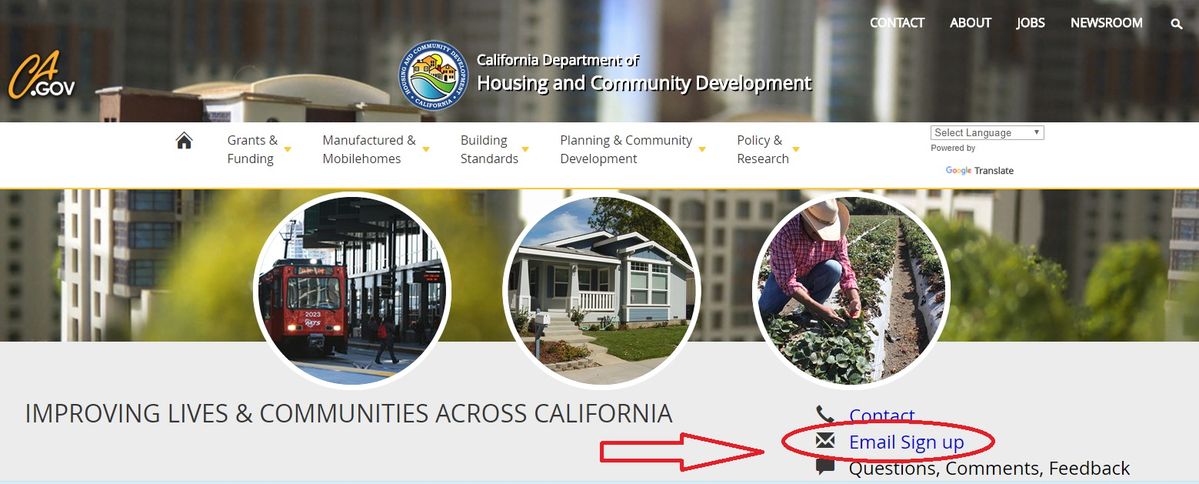
Stay in the know: Sign up for HCD email at www.hcd.ca.gov

Slide 49
Follow HCD on social media
Like us on Facebook: /CaliforniaHCD
Follow us on Twitter: @California_HCD
Follow us on LinkedIn: /company/californiahcd

